Slide 1
Lab 8: VAST package
May 17, 2018
Learning objectives:
Interpret multivariate spatio-temporal model results
Gain familiarity with VAST package

Slide 2
Can biogenic habitat be a “proxy” for rockfish habitat?
Steps:
Obtain bottom-trawl data for 8 rockfishes and biogenic habitat (soft corals + sponges)
Fit multispecies model
Interpret covariation
Compare single-species multispecies index of abundance
Thorson, and Barnett. 2017. Comparing estimates of abundance trends and distribution shifts using single- and multispecies models of fishes and biogenic habitat. ICES J. Mar. Sci. J. Cons.

Slide 3
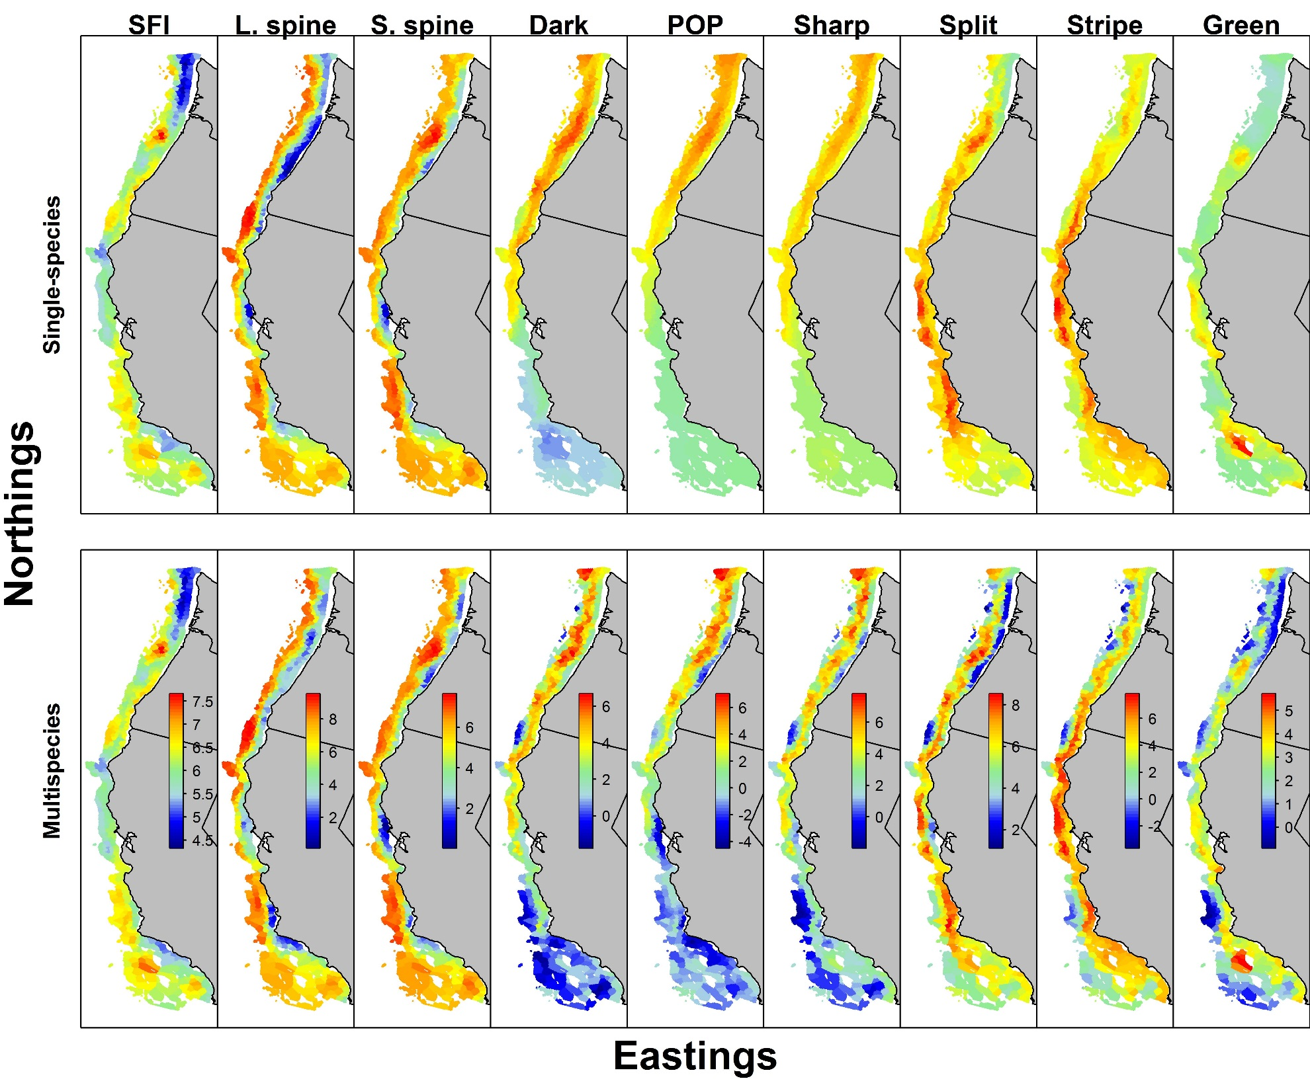
Can biogenic habitat be a “proxy” for rockfish habitat?
Single-species models are strongly smoothed
No fine-scale information for splitnose and sharpchin

Slide 4
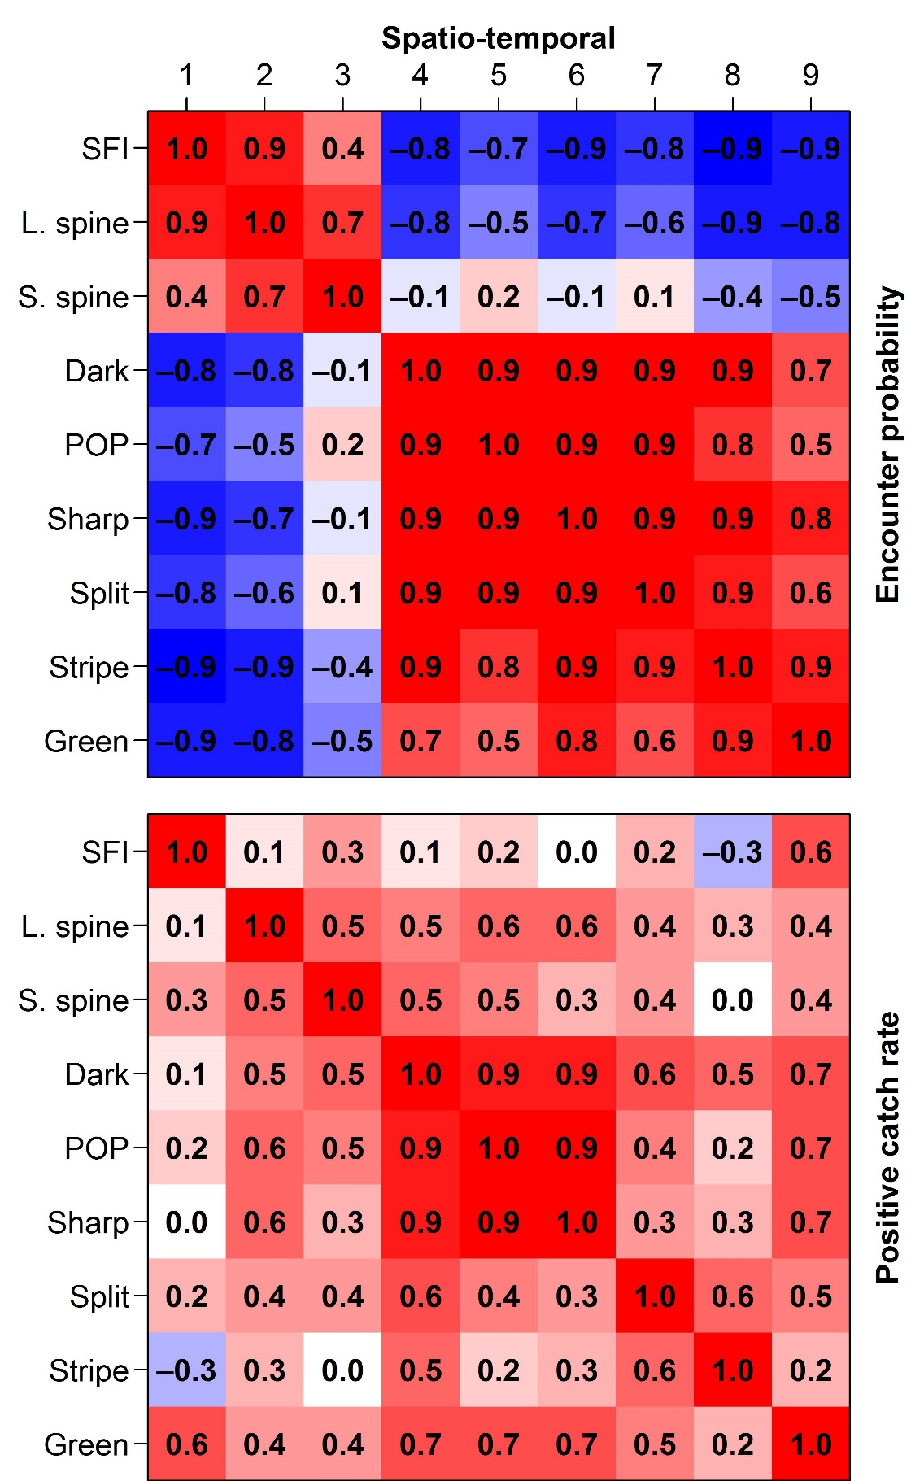

Covariance for spatio-temporal components of encounter probability and positive catch rates
Encounter probability shows two groups
SFI + Thornyheads VS rockfishes
Positive catch rate shows three groups
SFI + Thornyheads VS Northern rockfishes VS Coastwide rockfishes
Correlation: Encounter probability
Correlation: Positive catch rates

Slide 5
Can biogenic habitat be a “proxy” for rockfish habitat?
Multispecies model captures fine-scale variation
Shrinks stripetail towards greenstriped
Shrinks POP towards sharpchin

Slide 6
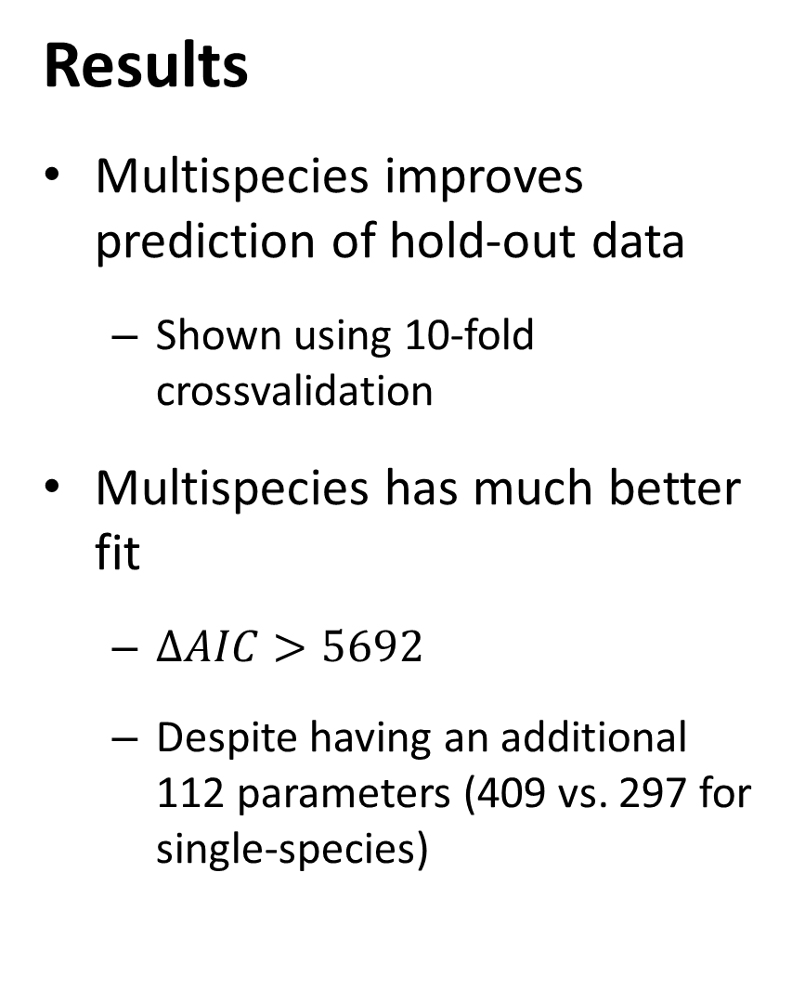
Results
Multispecies improves prediction of hold-out data
Shown using 10-fold crossvalidation
Multispecies has much better fit
$∆AIC>5692$
Despite having an additional 112 parameters (409 vs. 297 for single-species)
10-fold crossvalidation exercise
# | Predictive negative log-likelihood |  | Ratio of predictive probability
 | Single-species VAST model | Multispecies VAST model
1 | 8459.71 | 8078.84 | 1.057
2 | 8560.26 | 8209.90 | 1.053
3 | 8768.53 | 8377.45 | 1.059
4 | 8203.66 | 7815.19 | 1.058
5 | 8335.34 | 8009.96 | 1.049
6 | 8548.48 | 8154.91 | 1.059
7 | 8426.61 | 8133.02 | 1.044
8 | 8688.89 | 8335.62 | 1.052
9 | 8439.27 | 8077.01 | 1.055
10 | 8594.30 | 8271.42 | 1.048

Slide 7
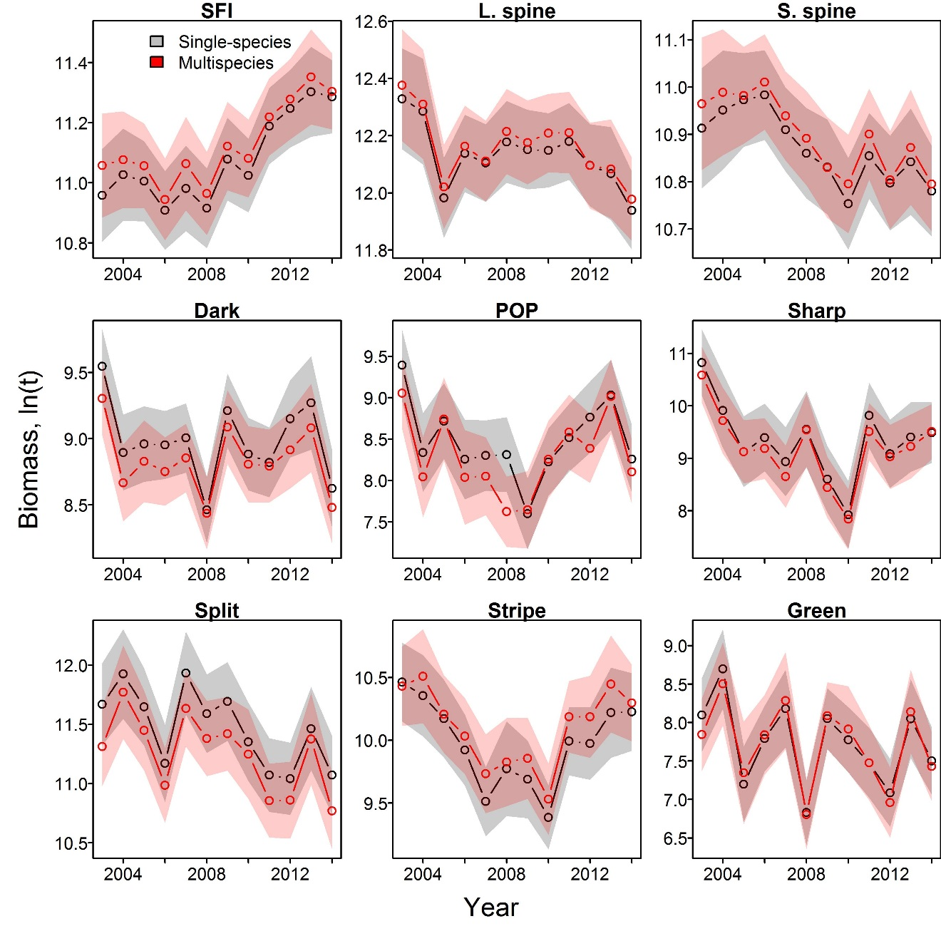
Results
Multispecies model doesn’t shrink intervals
Single-species has very similar standard errors
Multispecies shrinks species towards their group
Also doesn’t improve estimates of center-of-gravity
Indices of abundance for each species in analysis

Slide 8
Recommendations
Multispecies model is useful for…
Understanding covariation among species
Useful information ecologically
Essential fish habitat designation
Improves density predictions
Multispecies model is not useful for…
Index standardization for stock assessment
Adds complexity without improvement in precision
Climate-impact analysis
Too sensitive to model-specification for sensitive science issues

Slide 9
VAST package and FishStats toolbox
Spatio-temporal model
Benefits of single approach
Include biological mechanism
Improved communication
Similar review standards and “burden of proof”
Stock Assessment
Habitat Assessment
Integrated ecosystem assessment

Slide 10
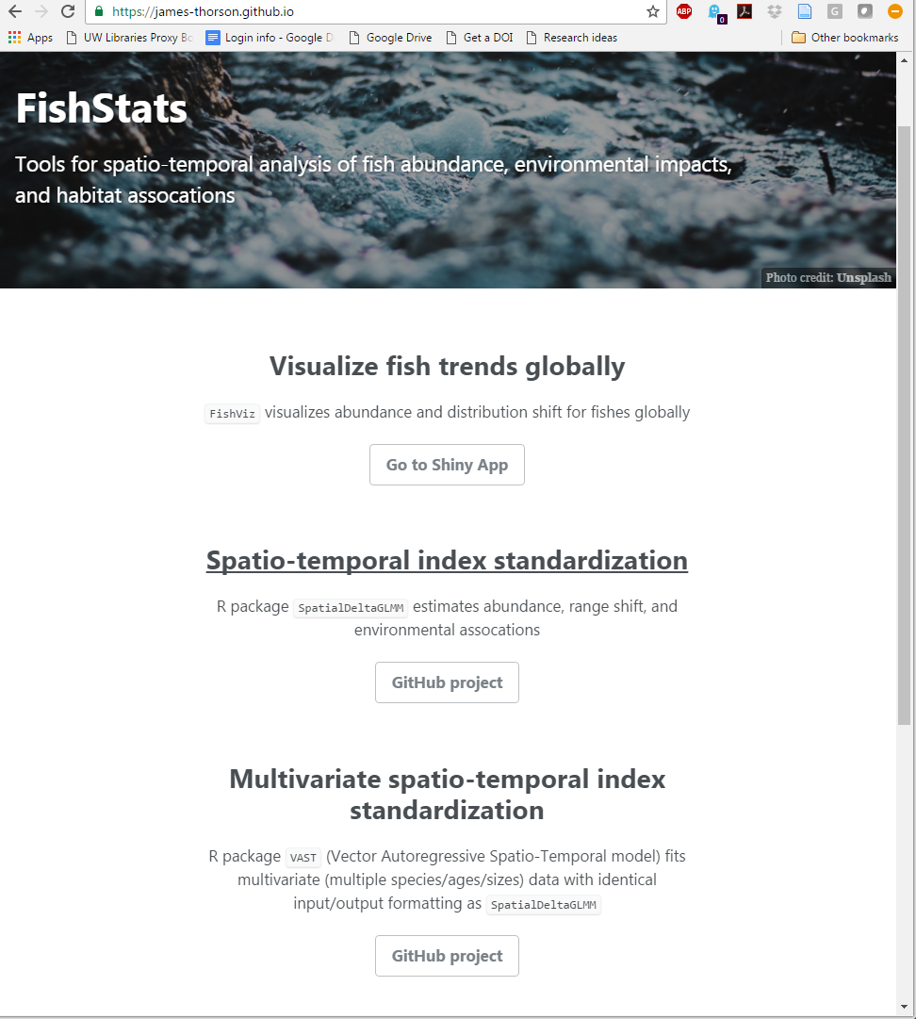
VAST package and FishStats toolbox
www.FishStats.org
FishViz
Visualizes results worldwide
SpatialDeltaGLMM
Single-species index model
VAST
Multi-species index model
SpatialVAM
Estimate species interactions
FishData
Scrape data worldwide
FishStats-listserv
Community updates by email

Slide 11
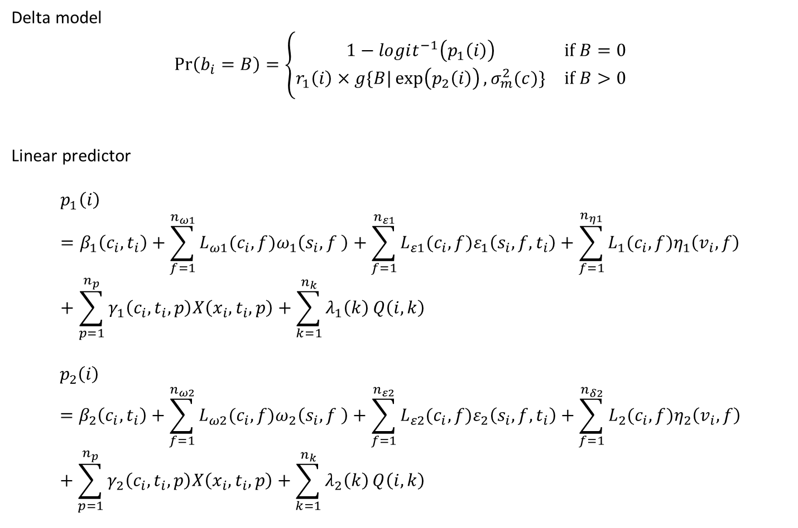
VAST package and FishStats toolbox
Delta model
$$\operatorname{Pr}\left(b_{i}=B\right)=\left\{\begin{matrix}1−logit^{−1}\left(p_{1}\left(i\right)\right) & if B=0 \\ r_{1}\left(i\right)×g\{\left.B|\exp\left(p_{2}\left(i\right)\right),σ_{m}^{2}(c)\}\right. & if B>0\end{matrix}\right.$$
Linear predictor
$$p_{1}\left(i\right)=β_{1}\left(c_{i},t_{i}\right)+\sum_{f=1}^{n_{ω1}}{L_{ω1}(c_{i}, f)ω_{1}\left(s_{i},f \right)}+\sum_{f=1}^{n_{ε1}}{L_{ε1}(c_{i}, f)ε_{1}\left(s_{i},f,t_{i}\right)}+\sum_{f=1}^{n_{η1}}{L_{1}(c_{i},f)η_{1}\left(v_{i},f\right)}+\sum_{p=1}^{n_{p}}{γ_{1}\left(c_{i}, t_{i},p\right)X\left(x_{i},t_{i},p\right)+\sum_{k=1}^{n_{k}}{λ_{1}\left(k\right)}Q\left(i,k\right)}$$
$$p_{2}\left(i\right)=β_{2}\left(c_{i},t_{i}\right)+\sum_{f=1}^{n_{ω2}}{L_{ω2}(c_{i}, f)ω_{2}\left(s_{i},f \right)}+\sum_{f=1}^{n_{ε2}}{L_{ε2}(c_{i}, f)ε_{2}\left(s_{i},f,t_{i}\right)}+\sum_{f=1}^{n_{δ2}}{L_{2}(c_{i},f)η_{2}\left(v_{i},f\right)}+\sum_{p=1}^{n_{p}}{γ_{2}\left(c_{i}, t_{i},p\right)X\left(x_{i},t_{i},p\right)}+\sum_{k=1}^{n_{k}}{λ_{2}\left(k\right)}Q\left(i,k\right)$$

Slide 12
VAST package and FishStats toolbox
[Look at single-species Rmarkdown script: https://github.com/James-Thorson/VAST/tree/master/examples]
[Look at multi-species Rmarkdown script: https://github.com/James-Thorson/VAST/tree/master/examples]

